Slide 1
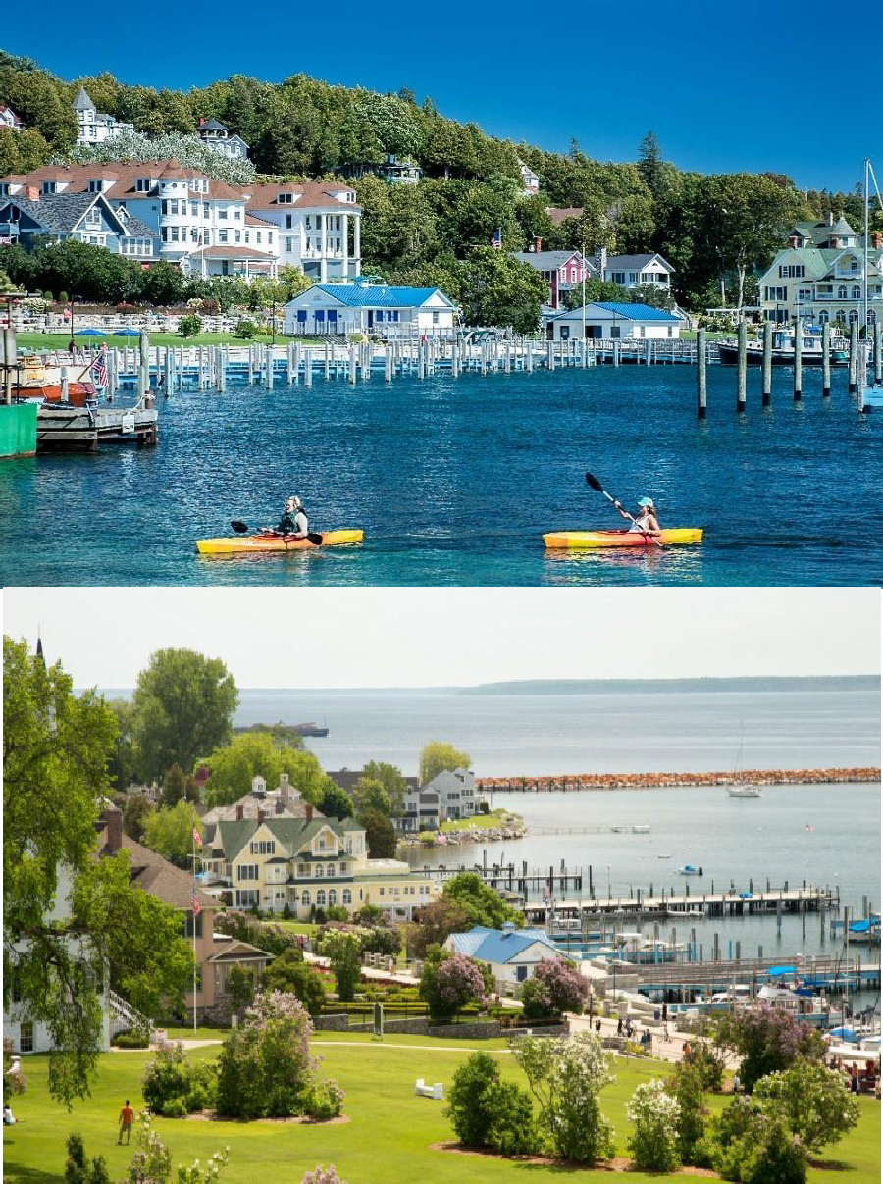
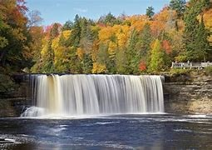
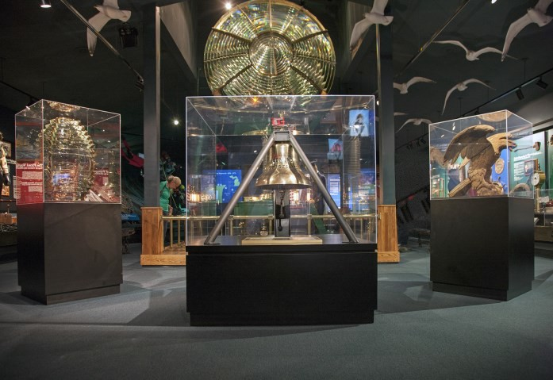
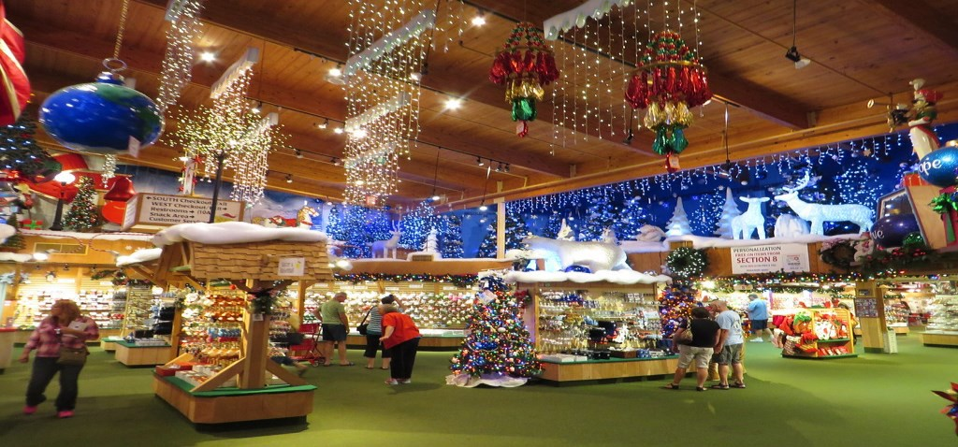
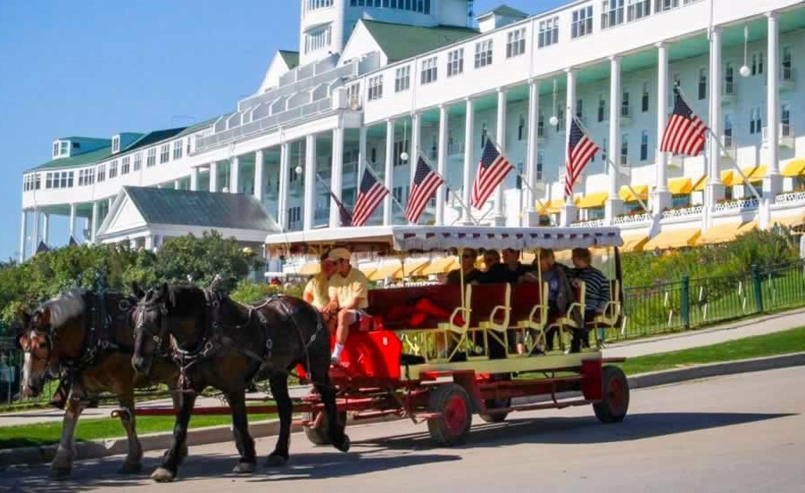
MACKINAC ISLAND
Including FRANKENMUTH & THE UPPER PENINSULA
5 DAYS - 4 NIGHTS
OCTOBER 6 - 10, 2024
^{$1649.00}Per Person Double Occupancy
$1918.00 Per Person Single Occupancy
PACKAGE INCLUDES:
Roundtrip flight from Austin to Michigan
4 Nights Lodging
4 Breakfasts
1 Lunch
4 Full Course Dinners, including Zehnder’s & Antlers
Soo Locks Boat Cruise
Bronner's Christmas Wonderland
Frankenmuth Village Shops
Horse-drawn Carriage Tour of Mackinac Island
Hydro-jet Ferry Ride
Visit to Grand Hotel
Tahquamenon Falls
Great Lakes Shipwreck Museum
Kewadin Shores Casino
Souvenir Gift
Luggage Handling at hotels
All Taxes & Meal Gratuities
Motorcoach Transportation in Michigan
Cancellation insurance is available & highly recommended; see reverse side for details.
FOR INFORMATION AND RESERVATIONS CONTACT: AARP #2700
Wynonie Bell 12306 Marogot Run
Austin, TX 78758
(512) 689-9823
26 E. Lancaster Avenue, Reading PA 19607 * 610-775-5000 * 800-437-2323 * www.whitestartours.com

Slide 2
THE BEST OF MICHIGAN
Upper Peninsula, Mackinac Island & Frankenmuth
5 Days - 4 Nights
The sample itinerary described below is approximately like the itinerary your group will be following during your stay with WHITE STAR TOURS. However, the exact times, days, and destinations may vary for your group.
Day 1
Depart from your hometown and travel to Frankenmuth, Michigan’s “Little Bavaria.” Spend the afternoon browsing at Bronner’s Christmas Wonderland and the other shops and attractions in this fascinating village. Check into your lodging and enjoy a family-style dinner at Zehnder’s Restaurant.
Day 2
After breakfast, spend the morning in Frankenmuth visiting the attractions you missed yesterday. Lunch is on your own in Frankenmuth, then travel northward to the Straits of Mackinaw arriving at your shoreside lodging for the next three nights. Dinner is included at a local restaurant.
Day 3
Breakfast, then board the high-speed, hydro-jet ferry for a fun ride to beautiful Mackinac Island. Upon arrival, board a horse-drawn carriage for a narrated tour of the island. After your tour, enjoy some time visiting the grounds, gardens and common area at the Grand Hotel. In the afternoon you will have time to explore the area on your own before returning via ferry to the mainland for a delicious dinner, followed by a couple hours at the Kewadin Shores Casino where you can try your luck.
Day 4
Breakfast, and then depart for a day on the Upper Peninsula. Arrive in Whitefish Point to visit the Great Lakes Shipwreck Museum. View the exhibits in the museum gallery, where shipwreck legends come to life. See the lighthouse keeper's quarters, and step inside the Shipwreck Theater to view a short documentary that details the loss of the Edmund Fitzgerald. You may even bravely dip your toes in frigid Lake Superior! After your visit, head to Tahquamenon Falls – the second largest waterfall east of the Mississippi River. Enjoy a "pasties" lunch at the Tahquamenon Falls Brewery & Pub included), followed by a walk to see the falls. Continue to Sault Ste. Marie and board the cruise boat for your Soo Locks Cruise – a relaxing 2-hour narrated cruise on St. Mary’s River as through the Soo Locks. After the cruise, depart for dinner at Antlers Restaurant. Return to your lodging for a restful evening.
Day 5
After breakfast at the hotel, check out and depart for home with fond memories of your visit to the
“mitten state.”
THANK YOU FOR ALLOWING WHITE STAR TOURS TO BE A PART OF YOUR TRAVEL PLANS!
TRIP CANCELLATION PROTECTION
Cancellation protection is encouraged for medical emergencies that may occur. The Enhanced option must be paid within 14 days from the day
the first deposit for the trip is paid to the organization and/or group leader. There is an additional Enhanced upgrade - Cancel for Any Reason. Cancellation must be made no later than 48 hours prior to your scheduled departure, conditions, limitations, and exclusions do apply. These plans are only valid for trips booked through White Star Tours. To purchase the protection, please contact NTA/AON Insurance via their website at
https://nta.aontravelprotect.com and provide the Tour Operator Location #386097.

